Slide 1
FeedEr
Course feedback and Survey App
- Anushree (1BM14CS021)
-Charishma B(1BM14CS031)
-Abhijeet Chauhan(1BM14CS003)
-Hemanth P (1BM14CS121)

Slide 2
What does it do?
An android application that provides basic utilities of:
-Feedback / Survey
-Academic Calendar

Slide 3
INTRODUCTION
This mobile application is a portal, where the faculty can add events, which are shown as upcoming tasks in the form of deadlines on the student’s dashboard in a highlighted date format, facilitated by caldroid component.
A student responds to rating bar type questions. The responses get stored in the local database (Shared Preferences), taken to the web based Django panel via a Retrofit Interface (Gson Model).

Slide 4
Tools used
1.Student Login (Android Studio)
2.Admin Login (Django)
(IP Configurations of both PC and Mobile handset should match)

Slide 5
Part I : android
Student Portal Can login
Can view upcoming deadlines
Can respond to feedback questions

Slide 6
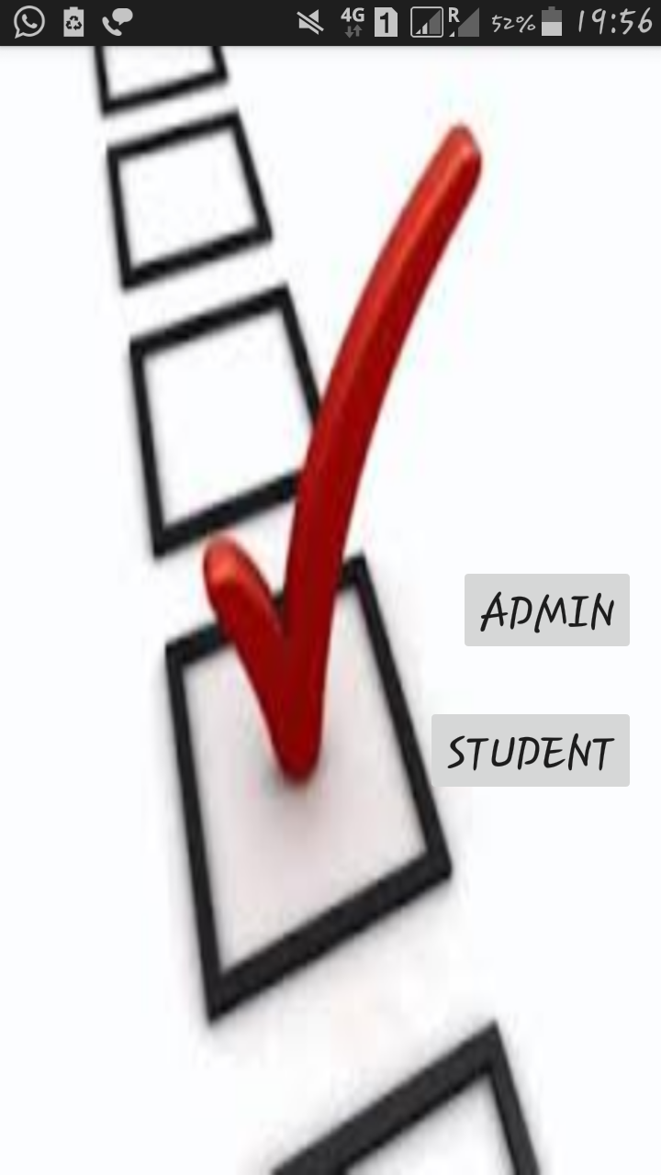
First Activity
Opens Browser
Opens Login Page

Slide 7
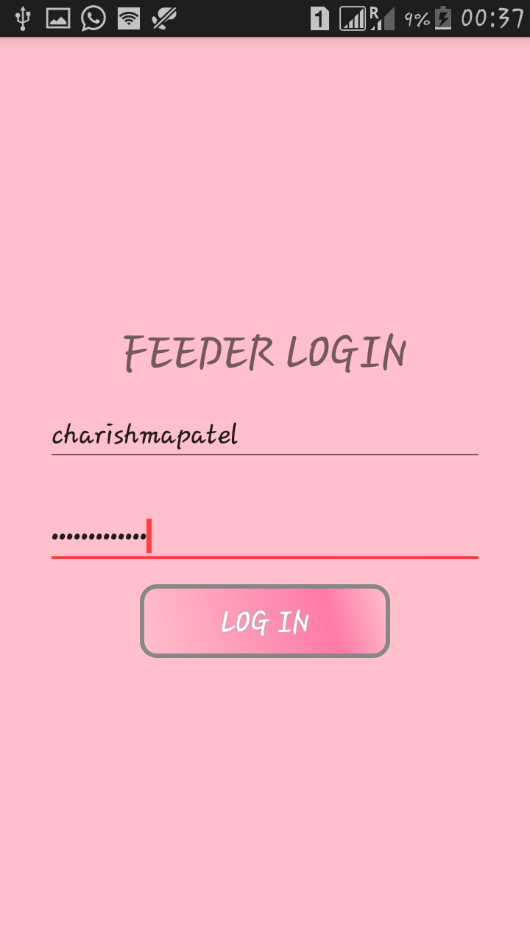
Student Portal
Opens Dashboard

Slide 8
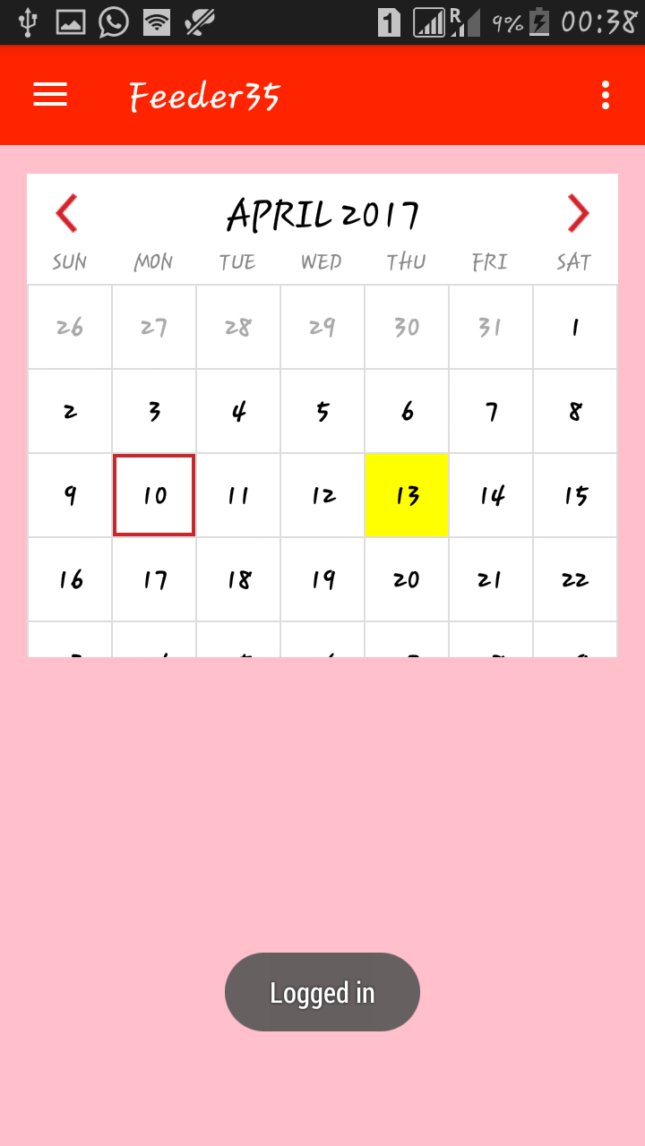
Dashboard
Logged In Status

Slide 9
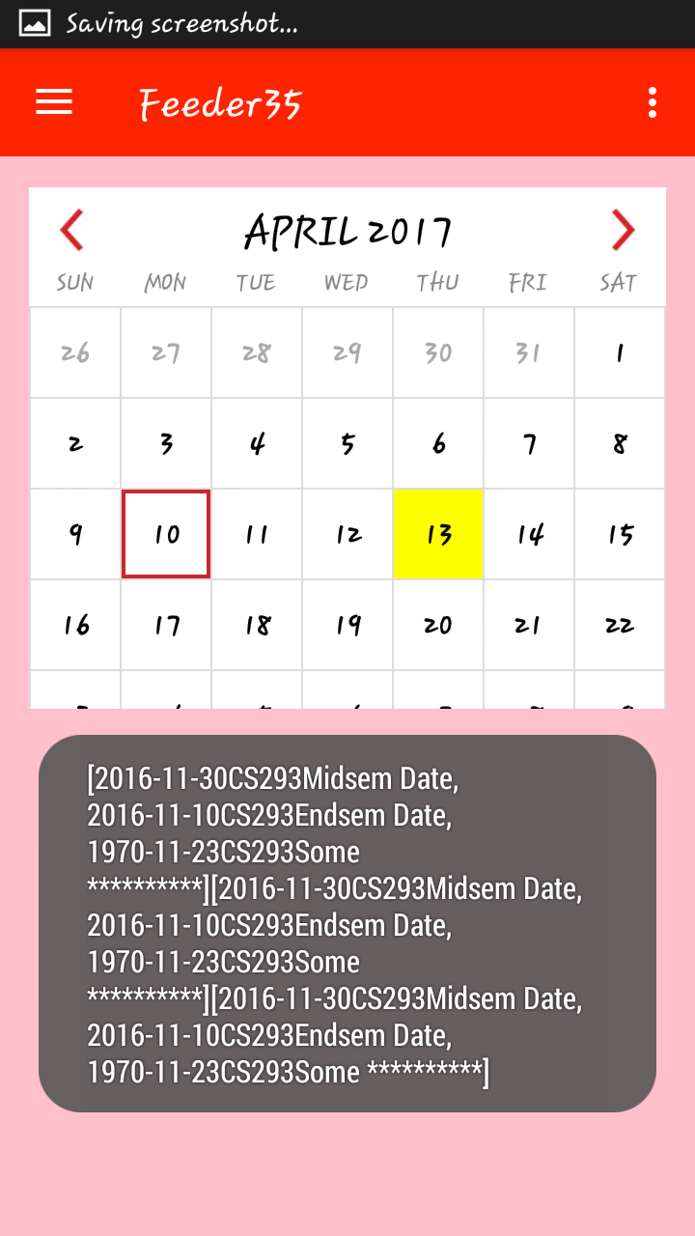
Summary Toast
Courses undertaken

Slide 10
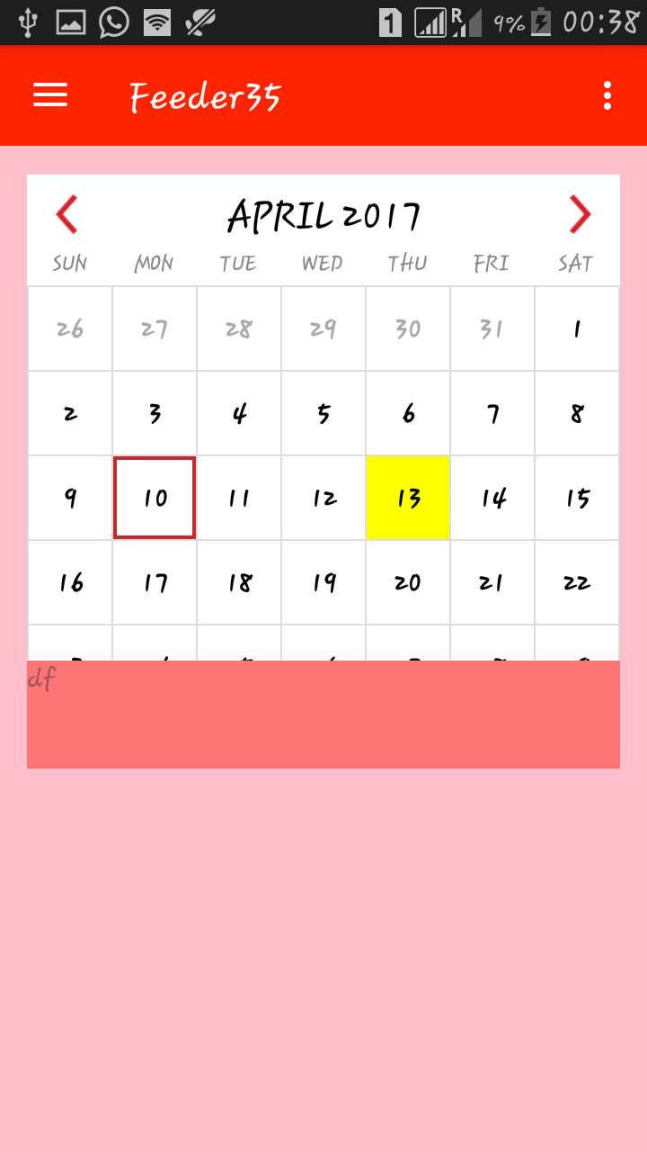
Upcoming Events
Dates
Events
Assignment and feedback list

Slide 11
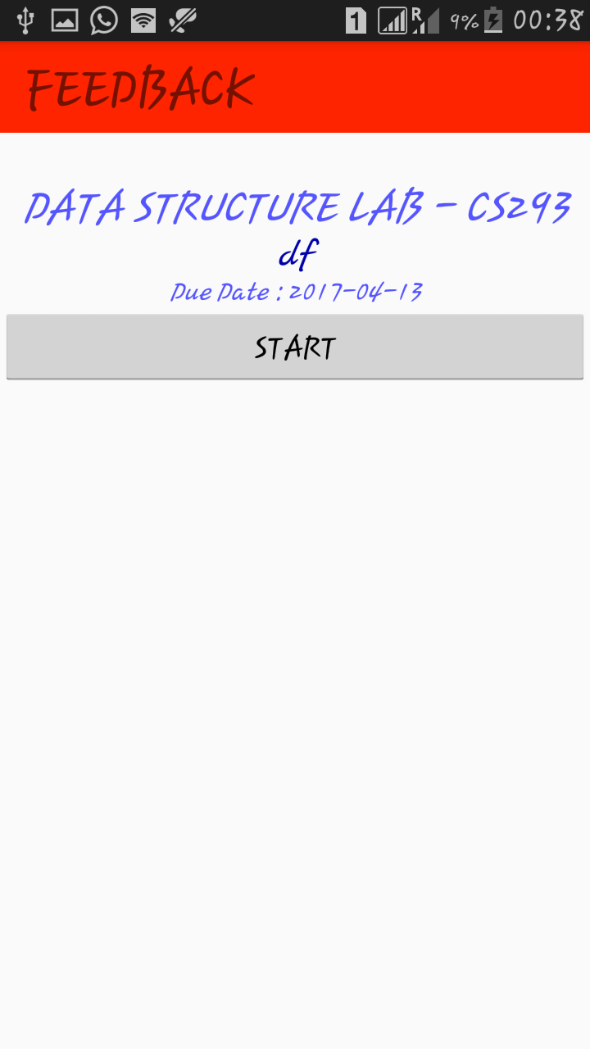
Feedback Page
Displays
Questions

Slide 12
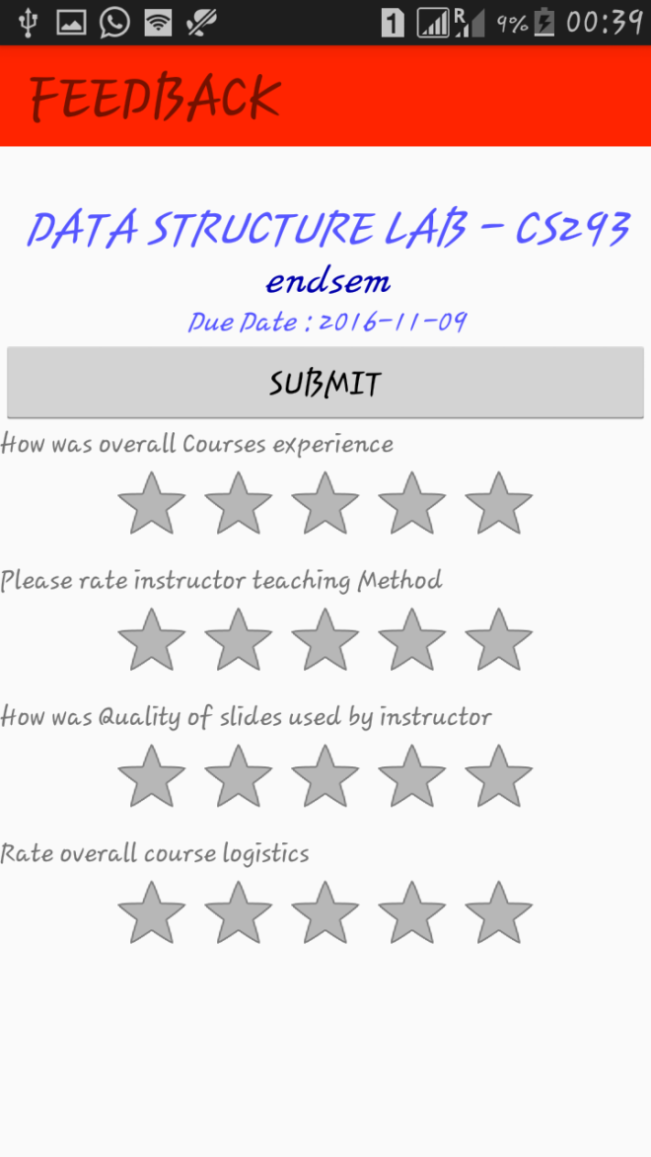
Feedback Questions
Rating Bar
Questions

Slide 13
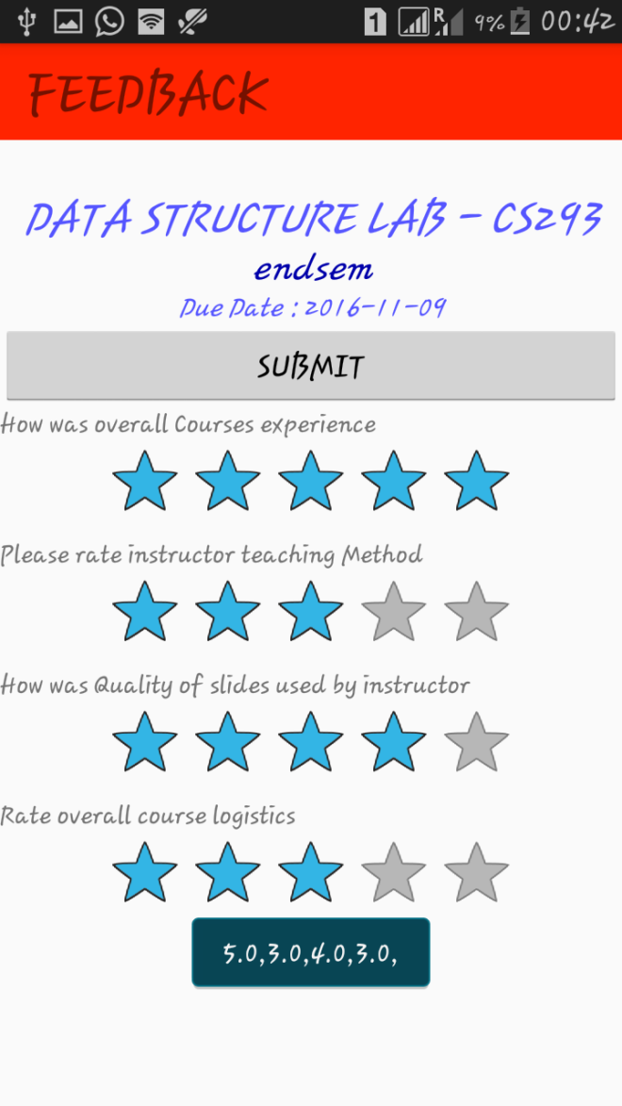
Student’s Response
Goes to Submissions
Responses
Confirmation
Toast

Slide 14
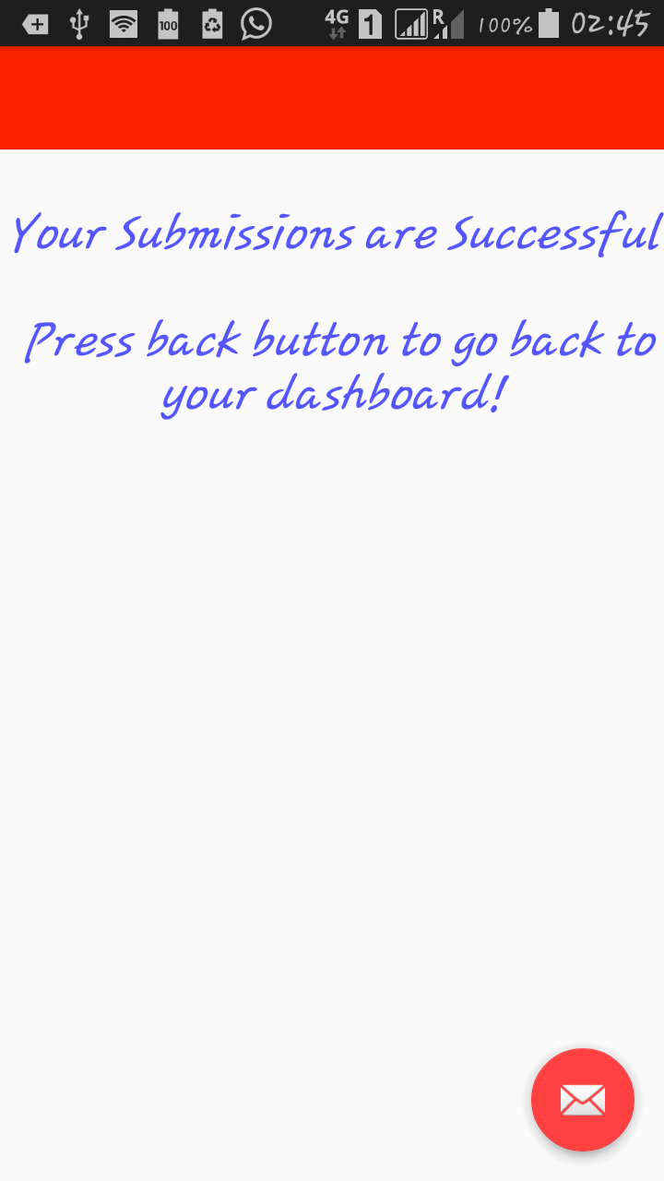
Response Status

Slide 15
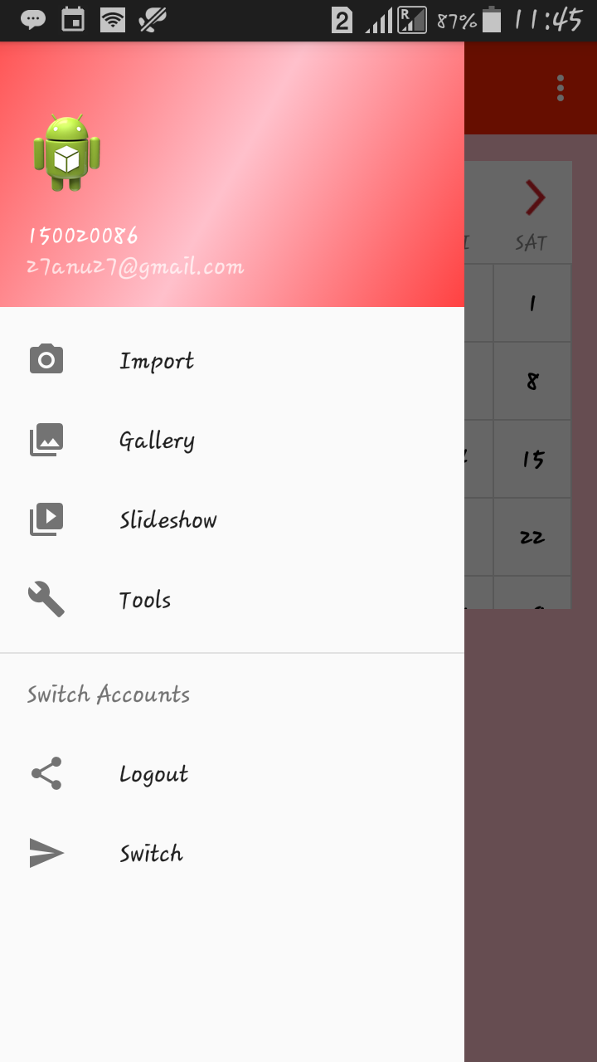
Drawer Widget
Student
Details
Destroys current variable

Slide 16
Main Activity
Opens Browser

Slide 17
Part ii: Django
Administrator: Can add upcoming events
Can enroll students
Can add questions to the feedback form
Can view feedback responses

Slide 18
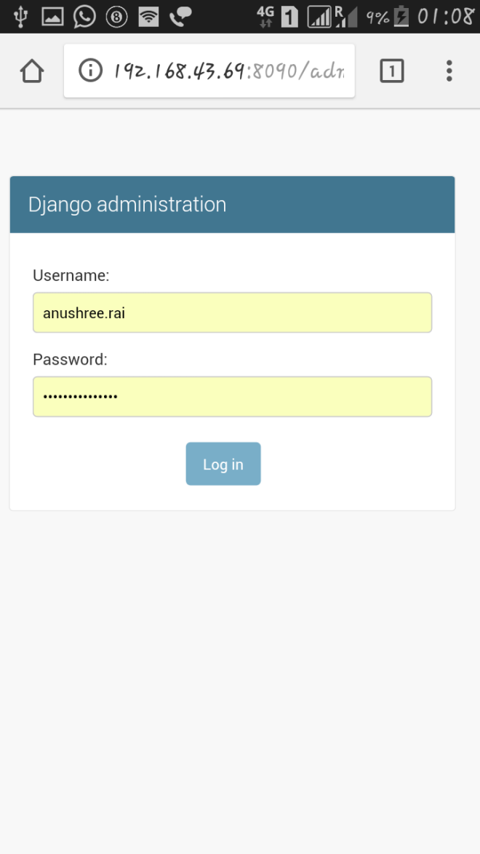
Faculty Login
Mobile Adjustable UI

Slide 19
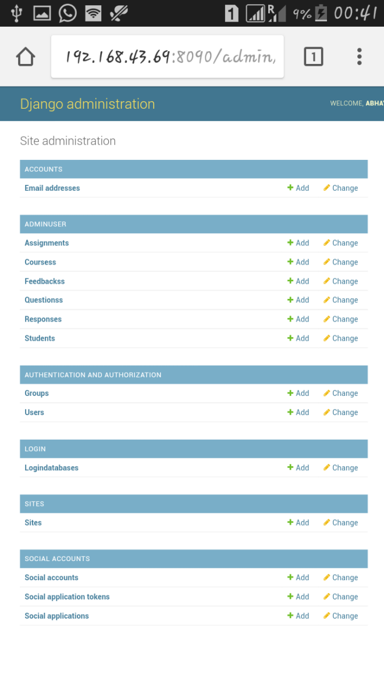
Admin Panel
Mobile Adjustable UI

Slide 20
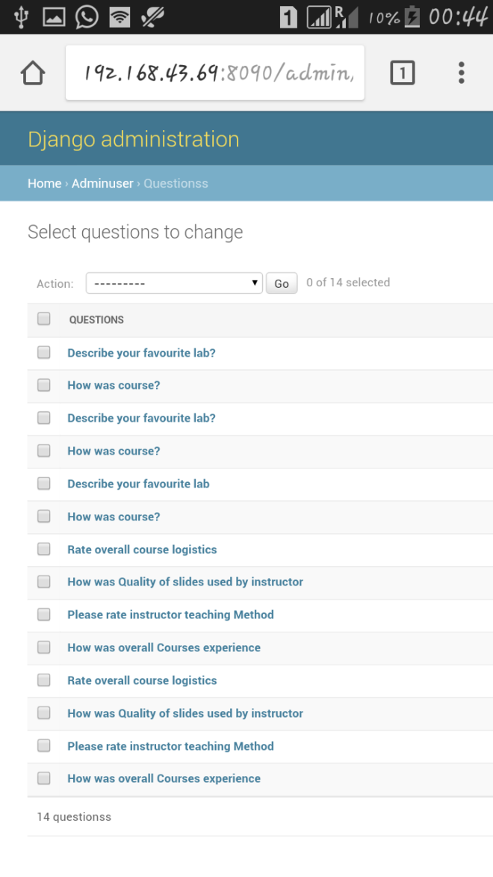
Add/Delete Questions
List of Feedback Questions

Slide 21
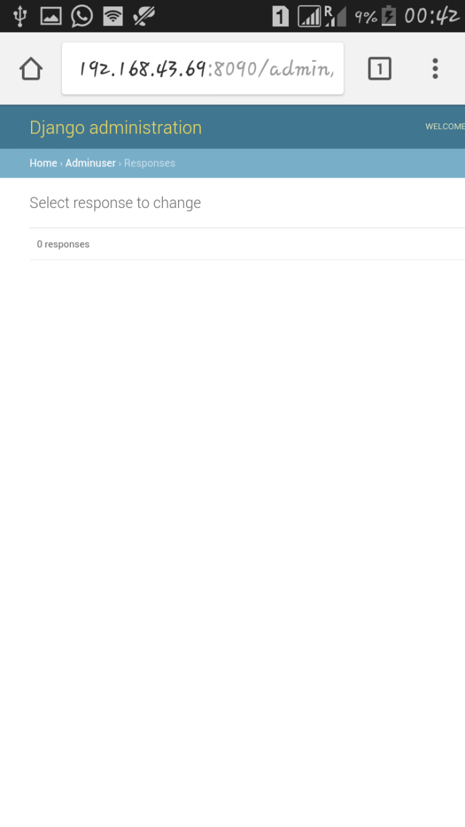
Pre Response Stage
No Responses

Slide 22
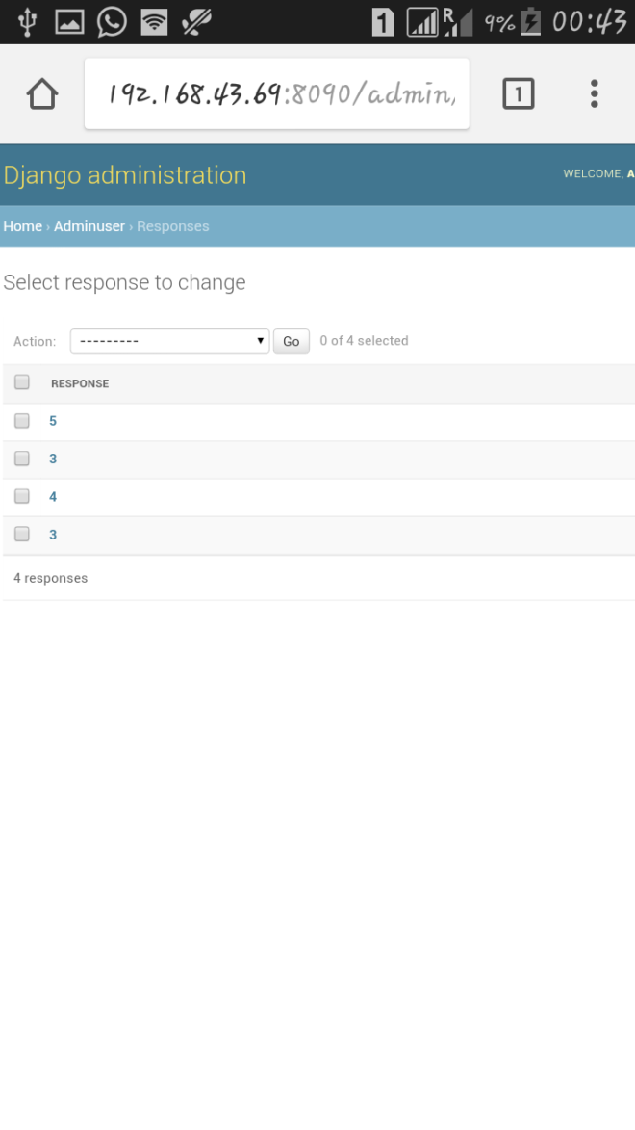
Post Response State
New Responses

Slide 23
Thankyou!

